Slide 1
TEXCYCLE AI
AI-Powered Digital Marketplace
for Upcycling Sri Lanka’s Textile Waste
PROJECT ID: R26-IT-081 | PANEL: IT-P06
IT22281814 • IT22215338 • IT22221278 • IT22281678
Supervisor: Prof. Dasuni Nawinna Co-supervisor: Mr. Nelum Amarasena

Slide 2





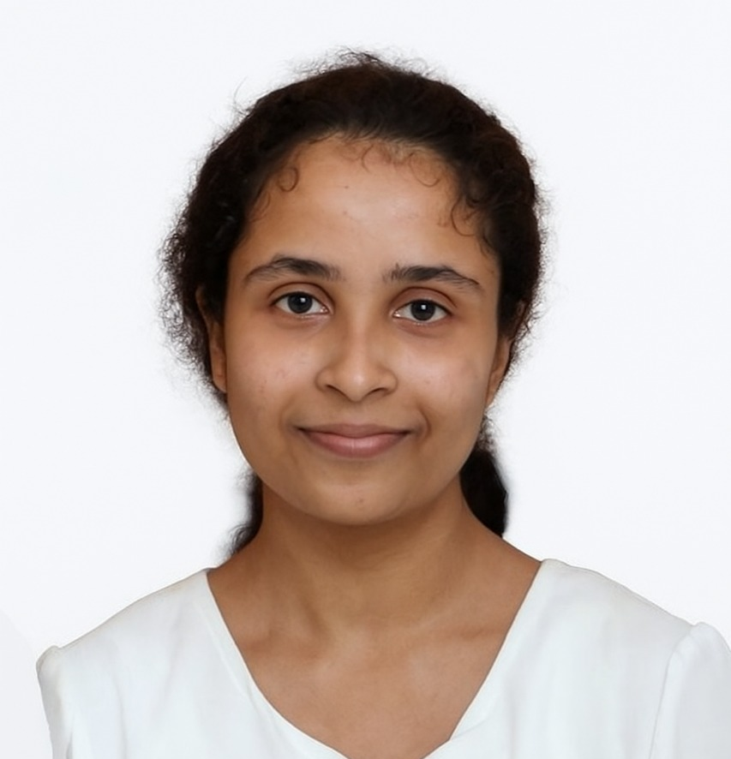
01 RESEARCH TEAM
Four members with distinct, connected responsibilities
Supervisor: Prof. Dasuni Nawinna
Co-supervisor: Mr. Nelum Amarasena
IT22281814 | Sandeepa S.A.C.
IT22215338 | Siriwardhana N.S.T.N
Fabric Intelligence
Sustainability Intelligence
IT22221278 | Madushanka H.M.T.G
IT22281678 | Thalagala T.A.D.V
Traceability + Commercial Intelligence
Marketplace Predictive Analytics
TEXCYCLE AI | R26-IT-081 | FINAL RESEARCH PRESENTATION
03

Slide 3
PP2 PANEL COMMENTS & ACTIONS TAKEN
Project R26-IT-081 | Panel IT-P06 | Actions across all four individual components
MEMBER / COMPONENT | PP2 PANEL COMMENT | ACTION TAKEN FOR FINAL PRESENTATION
Member 01 Fabric Intelligence | Progress was not sufficient for PP2. The implementation was basic, and the student could not clearly explain the model or outputs such as confidence and condition indicators. | Added the image-to-prediction workflow; clarified the reported fabric/defect models, confidence meaning, output interpretation, and which condition values are model-based versus rule/formula-based. Model metrics are labelled for verification.
Member 02 Sustainability Intelligence | Progress was not sufficient for PP2. The calculation of output values and the coding implementation were not clearly explained. | Added the actual pipeline: eight input features → preprocessing → six XGBoost regressors → formula-derived indicators → XGBoost grade classifier and label encoder. Distinguished predicted outputs from formula-derived values and explained assumptions/limitations.
Member 03 Commercial Intelligence | The panel did not see a clear understanding of the coding and implementation. Progress was considered insufficient for PP2. | Clarified the pricing and buyer-recommendation workflow, the reported XGBoost pricing approach, traceability events and the distinction between model predictions and marketplace workflow. Reported metrics are identified for verification.
Member 04 Marketplace Predictive Analytics | The student appeared unfamiliar with the coding and could not explain the code properly. Progress was considered insufficient for PP2. | Added model-task summaries for listing success, sales-time prediction and market trends; described the input feature groups and clarified that each metric must be tied to its target, test protocol and data quality.

Slide 4
02 PROJECT OVERVIEW
One platform, four research contributions
TexCycle AI connects textile assessment to sustainability information and marketplace decision support.
IDENTIFY
ASSESS
CONNECT + PREDICT
Understand the uploaded material and visible defects.
Estimate sustainability-related indicators with documented assumptions.
Support price decisions, buyer discovery and marketplace forecasting.
Core contribution
A role-based digital marketplace where AI outputs help users make more informed decisions about textile-waste reuse and upcycling.
TEXCYCLE AI | R26-IT-081 | FINAL RESEARCH PRESENTATION
02

Slide 5
03 INTRODUCTION
Why textile waste needs a smarter route to value
MATERIAL INFORMATION
VALUE UNCERTAINTY
FRAGMENTED DISCOVERY
Fabric type and condition may be unclear from a basic listing.
Sellers may need support estimating value and interpreting sustainability indicators.
Relevant buyers and market signals can be difficult to connect consistently.
Research alignment: SDG 12 — Responsible Consumption and Production; SDG 8 — Decent Work and Economic Growth.
TEXCYCLE AI | R26-IT-081 | FINAL RESEARCH PRESENTATION
04

Slide 6
04 RESEARCH PROBLEM & GAP
The challenge is a chain of connected decisions
PROBLEM A
PROBLEM B
PROBLEM C
Material category and condition are not always represented in a structured way.
Sustainability indicators and indicative values need clear calculation and interpretation.
Buyer matching and marketplace predictions need to be connected to listing information.
Research question
How can AI-assisted textile assessment and marketplace intelligence support informed reuse, upcycling and trading decisions?
TEXCYCLE AI | R26-IT-081 | FINAL RESEARCH PRESENTATION
05

Slide 7
05 OBJECTIVES
One main objective is supported by four component objectives
MAIN OBJECTIVE
Develop an AI-powered digital marketplace that helps users assess textile materials and make more informed sustainability and commercial decisions.
01 Identify material characteristics
02 Estimate sustainability indicators
Fabric classification and defect/condition assessment
Scores, grades and environmental estimates with explicit assumptions
03 Support commercial decisions
04 Predict marketplace patterns
Indicative pricing, buyer recommendation and traceability
Listing success, sales time, market trend, and demand were implemented
TEXCYCLE AI | R26-IT-081 | FINAL RESEARCH PRESENTATION
06

Slide 8
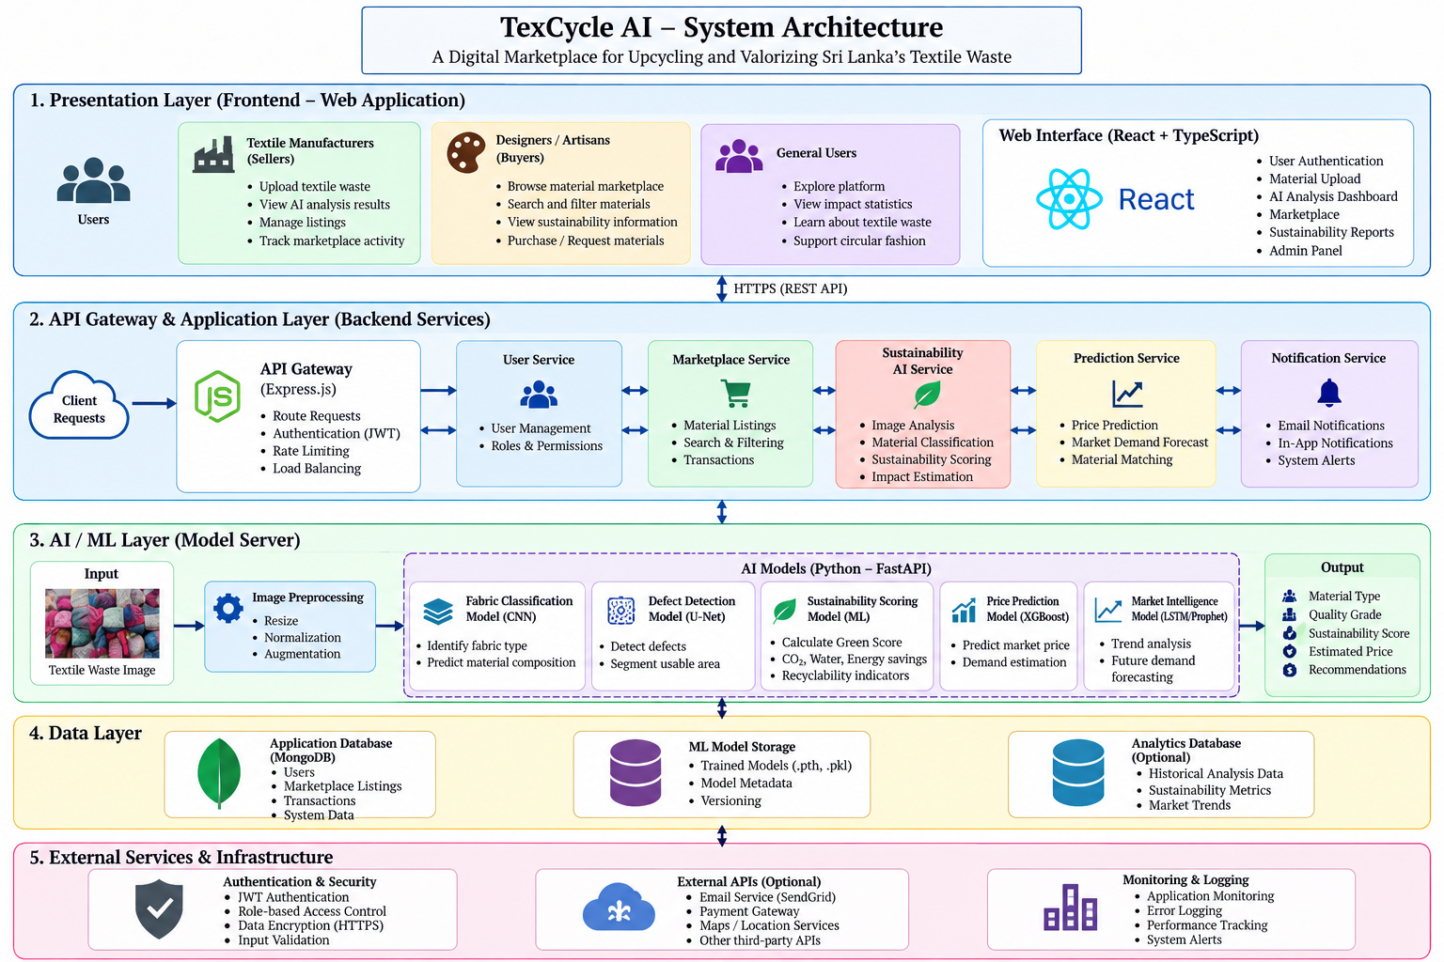
06 FULL SYSTEM ARCHITECTURE
How the website, backend, AI services, and data work together
TEXCYCLE AI | R26-IT-081 | FINAL RESEARCH PRESENTATION
07

Slide 9
07 USER ROLES & MARKETPLACE WORKFLOW
The same platform serves different users
SELLER
BUYER
ADMIN
SUPER ADMIN
Upload material
Analyses and list
View predictions
Manage sales
Browse materials
Choose quantity
Place orders
Track and review
Manage platform activity
Review users/listings
Monitor orders and reports
Platform-level access
Administrative governance
Shared services: authentication • marketplace listings • orders • notifications • reviews/ratings • history (as implemented)
TEXCYCLE AI | R26-IT-081 | FINAL RESEARCH PRESENTATION
08

Slide 10
08 RESEARCH METHODOLOGY
How the team moved from research to a working prototype
1
Literature + requirements
Identify problem, research gap and component targets
2
Dataset preparation
Review industry-visit notes and global/Sri Lankan reports where available; prepare and document component-specific datasets, labels and features. Identify any synthetic or derived records separately.
3
Model development
Train task-specific classifiers, regressors or segmentation models
4
Evaluation
Use task-appropriate metrics on held-out data
5
Integration
Connect inference/results to API and role-based website workflows
6
Testing + analysis
Test workflows, document limitations and interpret results
TEXCYCLE AI | R26-IT-081 | FINAL RESEARCH PRESENTATION
09

Slide 11
09 INDIVIDUAL RESEARCH CONTRIBUTIONS
Four components, four different research questions
MEMBER 01 | Fabric Intelligence
MEMBER 02 | Sustainability Intelligence
What material is it? What defects can be identified?
What environmental/sustainability indicators can be estimated?
MEMBER 03 | Commercial Intelligence
MEMBER 04 | Marketplace Predictive Analytics
What marketplace outcomes or trends can be predicted?
What price and buyer options may help the seller?
TEXCYCLE AI | R26-IT-081 | FINAL RESEARCH PRESENTATION
10

Slide 12
10 MEMBER 01 | IT22281814 | Sandeepa S.A.C.
Fabric Intelligence — research focus & solution
RESEARCH INPUT
MODELS REPORTED
USER OUTPUT
Uploaded textile image; image validation and preprocessing.
EfficientNet-B3 for fabric classification; MobileNetV2 for defect-related classification; U-Net for segmentation only if confirmed in final implementation.
Fabric category + confidence; defect result / mask where integrated; condition indicators only where implemented.
Reported result from earlier project notes: EfficientNet-B3 test accuracy 89.68%; MobileNetV2 result 90.87% (verify exact metric and task).
TEXCYCLE AI | R26-IT-081 | FINAL RESEARCH PRESENTATION
11

Slide 13
11 MEMBER 01 | METHOD
From textile image to a useful result
Upload
Preprocess
Inference
Post-process
Display
Image
Resize / normalize
Trained model
Class/mask
Prediction
TEXCYCLE AI | R26-IT-081 | FINAL RESEARCH PRESENTATION
12

Slide 14
12 MEMBER 02 | IT22215338 | Siriwardhana N.S.T.N
Sustainability Intelligence — model outputs and calculations
01 Circularity score
XGBoost Regressor
02 Sustainability grade
XGBoost Classifier + label encoder
03 Recyclability score
XGBoost Regressor
04 CO₂ saved (estimate)
XGBoost Regressor
Model/target scale
Exact implemented formula
Units + baseline factor
Grade model or mapping
05 Water saved (estimate)
XGBoost Regressor
06 Carbon reduction %
XGBoost Regressor
07 Water reduction %
XGBoost Regressor
08 Derived indicators
Energy, landfill, SDG & economic proxy scores
Units + baseline factor
Boundary + units
Inputs combined
Reuse/recycle/upcycle if implemented
Earlier notes report R² = 0.9389–0.9887 across sustainability experiments. Verify each value against its exact model, target and held-out test set before presenting it as a final result.
TEXCYCLE AI | R26-IT-081 | FINAL RESEARCH PRESENTATION
13

Slide 15
13 MEMBER 02 | METHOD
Member 02 method: inputs → predictions → derived indicators
STAGE 1 — MODEL-BASED
STAGE 3 — GRADE CLASSIFICATION
STAGE 2 — FORMULA-BASED
Inputs: fabric type, weight (kg), health score, repairability, condition, district, province and industry type. A saved preprocessor transforms inputs; six XGBoost regressors predict six indicators. Dataset preparation should be explained with the actual industry-visit/report sources used for this component.
A separate XGBoost classifier predicts the sustainability grade from the prepared feature row; a saved label encoder converts the class to its grade label.
Code-derived examples: energy_saved_kwh = CO₂_saved_kg × 1.5; landfill_diverted_kg = weight_kg × 0.95; SDG proxy = mean(circularity, recyclability). These are estimates/proxies, not measured impacts.
State input features and units.
Explain each predicted output and derived formula.
Disclose baselines and assumptions.
Outputs are clipped to defined ranges and rounded to 2 decimals.
No public hosting or independent environmental certification is claimed.
TEXCYCLE AI | R26-IT-081 | FINAL RESEARCH PRESENTATION
14

Slide 16
14 MEMBER 03 | IT22221278 | Madushanka H.M.T.G
Commercial Intelligence — pricing and buyer recommendation
PRICE MODEL
BUYER RECOMMENDATION
TRACEABILITY
XGBoost Regressor
MAE 12.24 • RMSE 15.40
R² 0.9590 (prior reported result)
Prior notes describe Random Forest + XGBoost. Reported matching result: 83.56%; verify how matching quality was measured.
Track analysis/listing/order events and history where implemented. Traceability is a system workflow, not automatically an ML model.
Commercial flow
Material + condition + quantity + market features → feature preparation → price estimate/buyer suggestions → seller decision.
TEXCYCLE AI | R26-IT-081 | FINAL RESEARCH PRESENTATION
15

Slide 17
15 MEMBER 03 | METHOD
Traceability links the material journey
Material
Analysis
Listing
Order
Feedback
Upload / details
Outputs / history
Published offer
Status / delivery
Review / rating if implemented
Why it matters
What it cannot prove alone
A more structured history can support visibility and accountability.
Records alone do not verify origin or environmental impact.
TEXCYCLE AI | R26-IT-081 | FINAL RESEARCH PRESENTATION
16

Slide 18
16 MEMBER 04 | IT22281678 | Thalagala T.A.D.V
Marketplace Predictive Analytics — model tasks
LISTING SUCCESS
SALES TIME
MARKET TREND
DEMAND
XGBoost Classifier
Reported accuracy: 83.65%
Define the success label.
XGBoost Regressor
Prior notes: MAE 14.53 days; RMSE 20.87; R² 0.76
Increasing / Stable / Decreasing classes. Prior reported accuracy: 98.72%; verify the test protocol.
Present separately only if a distinct trained model and evaluation exist.
TEXCYCLE AI | R26-IT-081 | FINAL RESEARCH PRESENTATION
17

Slide 19
17 MEMBER 04
Marketplace dataset and feature groups
Material/condition
Sustainability/price
fabric_type • condition • health_score • defect_area
• repairability • remaining_lifespan • weight_kg
sustainability_score • green_score • co2_saving • water_saving • predicted_price • average_market_price
Market context
Seller/engagement
buyer_type • demand_level • listing_month • season • district • province • competition • economic_index
seller_rating • weekly_views • wishlist_count • click_rate • seller_experience • listing_status • days_to_sell
TEXCYCLE AI | R26-IT-081 | FINAL RESEARCH PRESENTATION
18

Slide 20
18 INTEGRATED USER JOURNEY
How the four components work together on the website
01 • Upload
Seller uploads an image and enters material details.
02 • Identify
Member 01 model classifies fabric and analyses defects where supported.
03 • Assess
Member 02 produces sustainability indicators and environmental estimates.
04 • Commercialise
Member 03 provides indicative price, buyer recommendations and traceability.
05 • Predict + trade
Member 04 provides marketplace predictions; users continue through listings and orders.
Claim automatic data hand-offs only where the current code implements them; otherwise, describe the components as connected through shared workflows.
TEXCYCLE AI | R26-IT-081 | FINAL RESEARCH PRESENTATION
19

Slide 21
19 SUMMARY
Report the metric that matches the model task
Task | Model / method | Prior reported result | Required verification
Fabric classification | EfficientNet-B3 | Accuracy 89.68% | Confirm classes / test split
Defect model | MobileNetV2 / U-Net | 90.87% reported | Confirm exact metric and model
Price prediction | XGBoost regressor | MAE 12.24 • RMSE 15.40 • R² 0.9590 | Confirm currency/unit
Listing success | XGBoost classifier | Accuracy 83.65% | Confirm success label
Sales time | XGBoost regressor | MAE 14.53 days • RMSE 20.87 • R² 0.76 | Weak explanatory power
Market trend | Classifier | Accuracy 98.72% reported | Check generated labels / leakage
Buyer recommendation | RF + XGBoost approach | 83.56% reported | Define evaluation protocol
Sustainability models | Regressors / grade model | R² range 0.9389–0.9887 | Map each value to target
TEXCYCLE AI | R26-IT-081 | FINAL RESEARCH PRESENTATION
20

Slide 22
ALL MEMBERS
21 LIMITATIONS & NEXT VALIDATION
Limitations, testing status and future improvements
DATA SOURCES
MODEL VALIDATION
DEPLOYMENT & IMPACT
Dataset sources differ by component. Industry visits and global/Sri Lankan industry reports informed dataset preparation where documented. The marketplace predictive dataset includes synthetic/prototype records; therefore, real buyer behaviour, transaction prices and seasonal demand still require validation.
Reported metrics must be verified for each model and target. Check for data leakage and evaluate on independent held-out data. Report only metrics supported by the relevant test evidence.
The prototype was tested locally and reviewed by external users/stakeholders. Feedback was positive, and users expressed satisfaction with the system. The prototype has not been publicly hosted. Independent environmental-impact certification remains future work. Next steps: secure deployment and broader validation.
TEXCYCLE AI | R26-IT-081 | FINAL RESEARCH PRESENTATION
22

Slide 23
RESULTS, TESTING & FUTURE IMPROVEMENTS
Prototype status — tested locally and reviewed by external users/stakeholders. Feedback was positive and users expressed satisfaction. The prototype has not been publicly hosted.
Earlier notes report sustainability R² values from 0.9389–0.9887. Verify each model, target, dataset source, split and held-out result before treating these as final.
Functional testing
Demonstrate locally: input validation → preprocessing → model predictions → derived indicators → grade response. Add pass/fail evidence only from tests actually run.
External users/stakeholders reviewed and tested the locally run prototype. Feedback was positive, and users expressed satisfaction with the system. Keep available test notes, feedback and screenshots as supporting evidence. No numeric satisfaction rate or independent benchmark score is claimed.
Limitations
Not publicly hosted; environmental savings are estimates based on model outputs and code-defined factors; prototype/synthetic data may not represent real Sri Lankan market behaviour.
Future improvements
Deploy securely; broaden testing with more sellers, buyers and textile stakeholders; collect real listings and transactions; validate environmental factors; report MAE/RMSE/R² or accuracy/precision/recall/F1 as appropriate.

Slide 24
REFERENCES
ALL MEMBERS
Reference slide — align with the approved thesis bibliography
[1] Ellen MacArthur Foundation, A New Textiles Economy: Redesigning Fashion’s Future, 2017.
[2] United Nations Environment Programme, Sustainability and Circularity in the Textile Value Chain: A Global Roadmap, 2023.
[3] United Nations, The 17 Goals: Sustainable Development Goals, sdgs.un.org/goals.
[4] Tan, M. and Le, Q. V., “EfficientNet: Rethinking Model Scaling for Convolutional Neural Networks,” ICML, 2019.
[5] Sandler, M. et al., “MobileNetV2: Inverted Residuals and Linear Bottlenecks,” CVPR, 2018.
[6] Ronneberger, O., Fischer, P. and Brox, T., “U-Net: Convolutional Networks for Biomedical Image Segmentation,” MICCAI, 2015.
[7] Chen, T. and Guestrin, C., “XGBoost: A Scalable Tree Boosting System,” KDD, 2016.
[8] Breiman, L., “Random Forests,” Machine Learning, vol. 45, pp. 5–32, 2001.
TEXCYCLE AI | R26-IT-081 | FINAL RESEARCH PRESENTATION
25

Slide 25
Thank You!

